Slide 1
Engaging Neighbors: How Fort Lauderdale Builds Community
Engaging the Neighbors of Fort Lauderdale
Ryan Henderson
City of Fort Lauderdale
December, 2014

Slide 2
Engaging Citizens
“In government, you can’t wait for people to come to you --- you need to give residents the tools to empower themselves in the most convenient way.”
Los Angeles Mayor Eric Garcetti

Slide 3
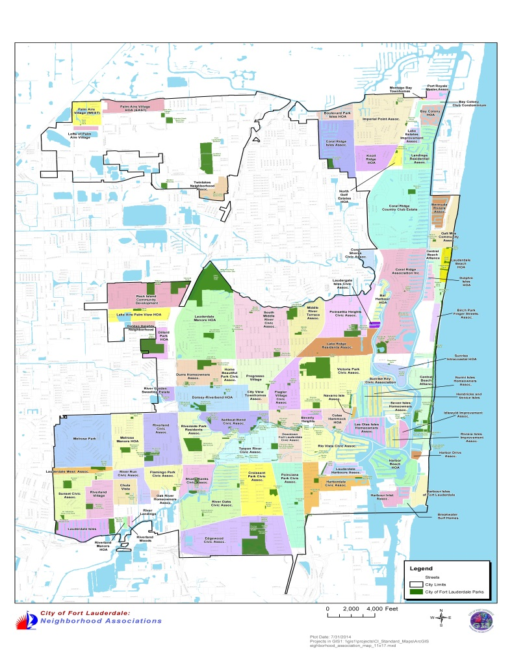
City of Fort Lauderdale and Neighborhood Associations
Fort Lauderdale is a unique City in that there are 84 Home/Civic Associations throughout the diverse City. Challenge exists to engage all.

Slide 4
Where are the Opportunities?
The key to effectively engaging our neighbors is locating where the opportunities
exist to engage.
Visioning Process
Neighbor Volunteer Office
Special Projects

Slide 5
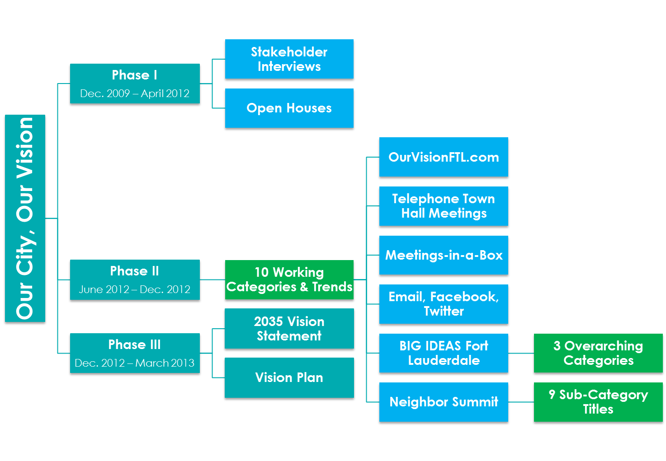
City of Fort Lauderdale Visioning Process

Slide 6
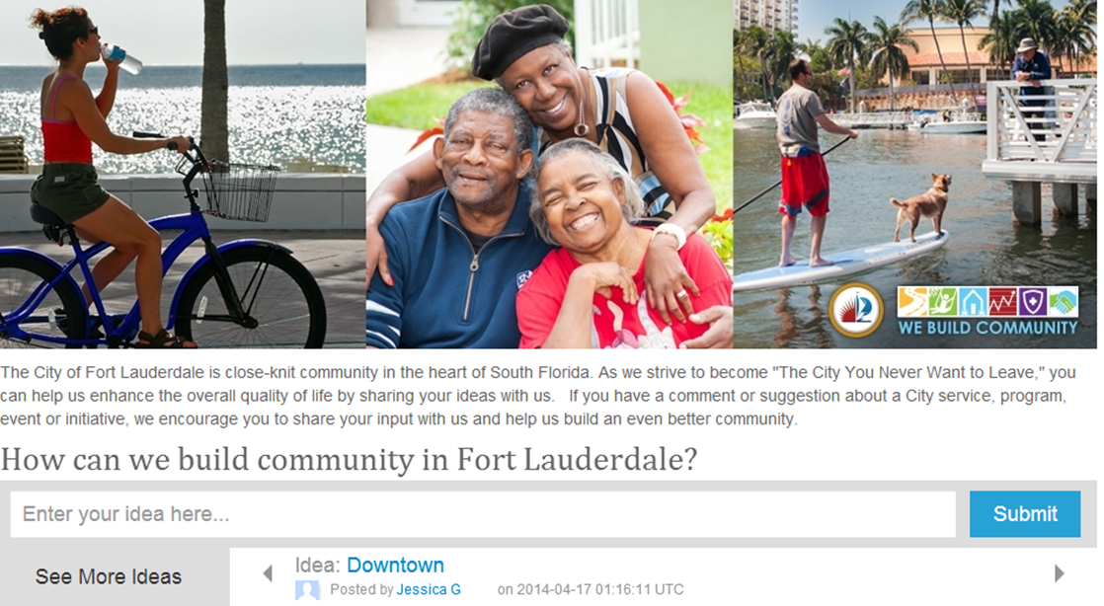
OurVisionFTL.com

Slide 7
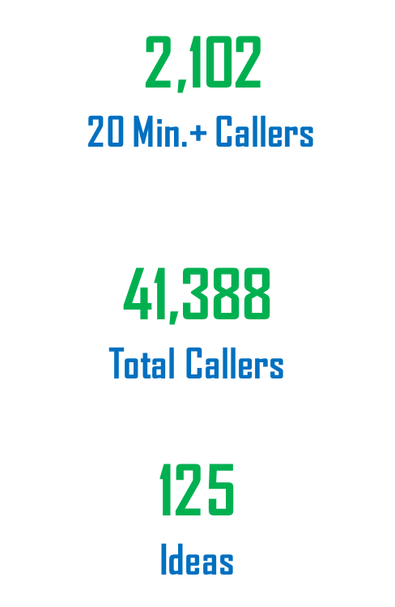
Telephone Town Halls

Slide 8
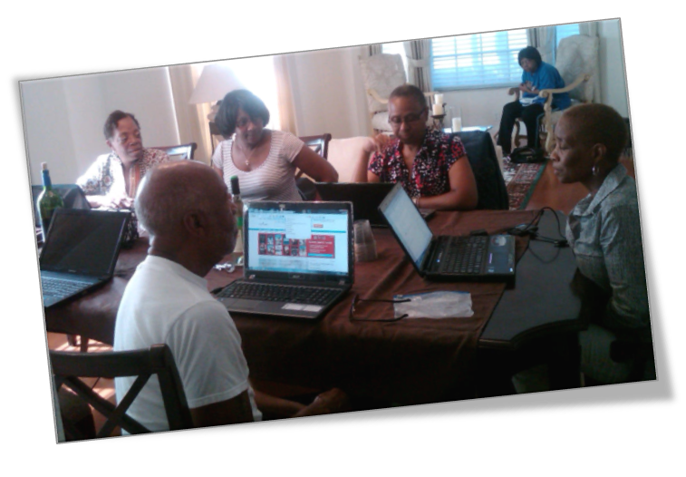
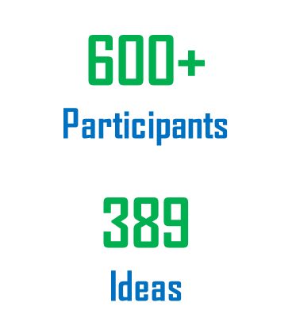
Meetings In-A-Box

Slide 9
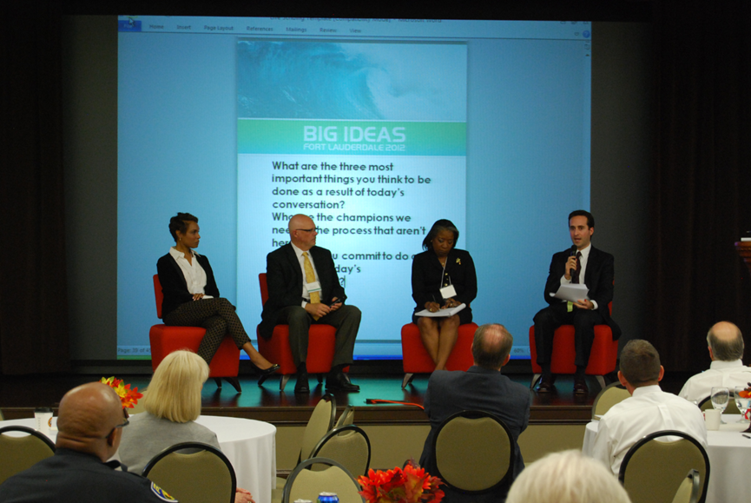
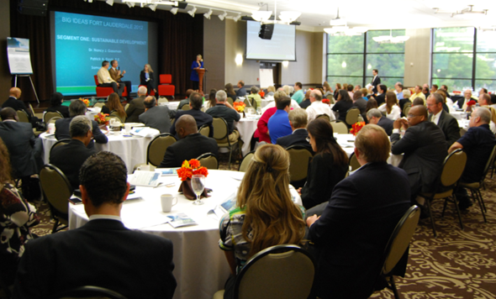
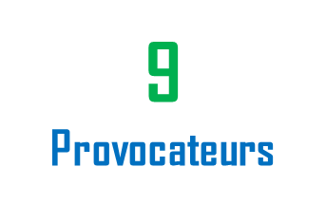
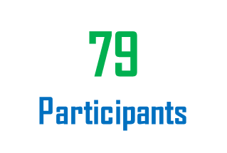
BIG Ideas Fort Lauderdale

Slide 10
Nextdoor
Nextdoor, created in 2011, is a social media program specifically for neighborhoods.
Nextdoor does not currently generate revenue. They are funded by venture capital firms, allowing them to focus 100% of their efforts on improving the site and bringing it to neighborhoods.
Neighbors are able to use the site to:
Get to know their neighbors
Share information about traffic, lost pets, crime and emergency preparedness
Receive and comment on important information from city officials

Slide 11
Nextdoor and City of Fort Lauderdale Partnership
Nextdoor came to the attention of the City of Fort Lauderdale through Alliance for Innovation and had representation at the Florida League of Cities Conference in August 2012.
The program was introduced in late 2012 by City staff to the Council of Fort Lauderdale Civic Associations where it was well-received. Information was sent to all neighborhood association presidents introducing the program and inviting them to join.
Our motto is “We Build Community.” We’ve found that Nextdoor aids us in doing that.

Slide 12
Status of the City of Fort Lauderdale and Nextdoor
On August 15, 2012 the City of Fort Lauderdale became the first City in Florida to launch Nextdoor. Since that date, Nextdoor has become an integral part of many of our neighborhoods’ communication networks.
Nextdoor does not currently generate revenue. They are funded by venture capital firms. Their funding allows them to focus 100% of their efforts at this time on improving Nextdoor and introducing the service to new neighborhoods.
Nextdoor has been introduced 72 Fort Lauderdale neighborhoods are on connected on Nextdoor. Our Public Works department utilizes Nextdoor to communicate.
There are 4,362 Fort Lauderdale citizens connected on Nextdoor and they have contributed 16,623 unique posts.

Slide 13
Success of Nextdoor in the City of Fort Lauderdale
These numbers are growing monthly. In late April, 2013, 47 neighborhoods were connected and 1,486 neighbors posted 3, 426 messages to each other on Nextdoor.
As a City we have been using Nextdoor to share information about upcoming events, new programs, traffic advisories, and sever weather alerts.
Nextdoor provides a great platform to share exciting new developments citywide as well as personalized neighborhood security concerns on a neighborhood level.

Slide 14
City of Fort Lauderdale’s Nextdoor Page
As a City we have a Nextdoor page that allows us to post content to our neighbors.
http://cityoffortlauderdale.nextdoor.com/news_feed/
We can post messages with pictures, videos, links, or documents. We can post the messages City-wide or to select neighborhoods.
We are provided with a map of our neighborhoods and can view which are inactive, which are in the “Pilot” stage and which are “Launched.”

Slide 15
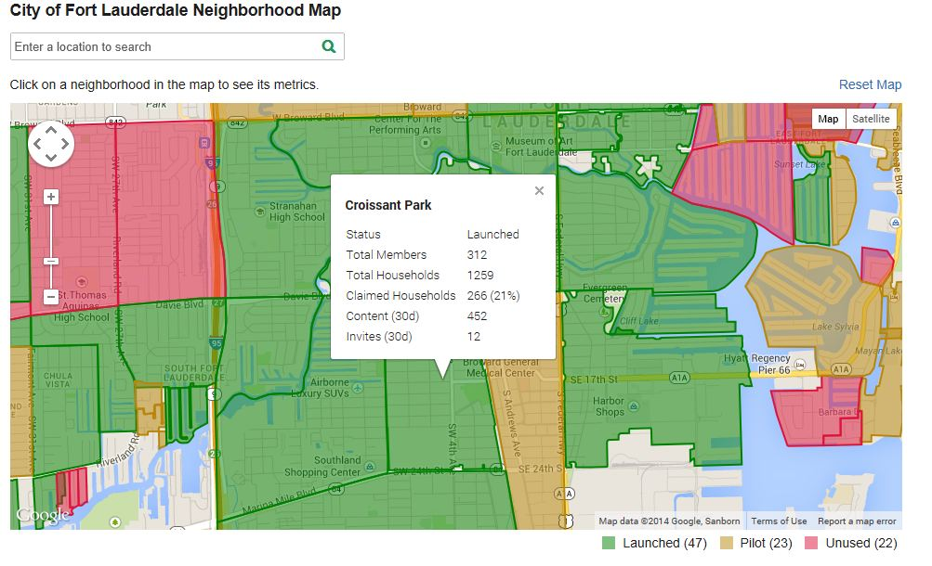
Viewing Neighborhoods through Nextdoor

Slide 16
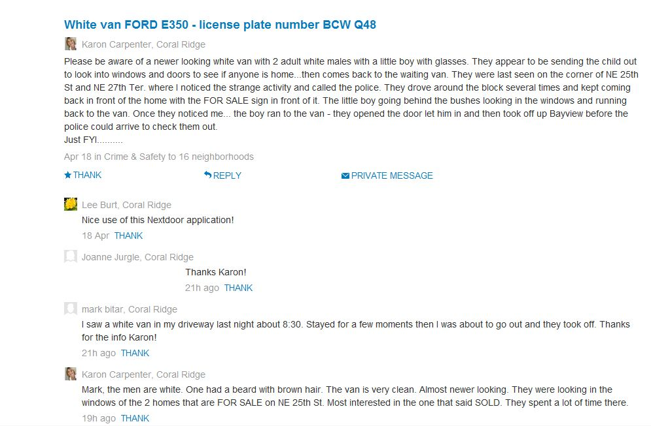
Application of Nextdoor

Slide 17
Fort Lauderdale Police Department on Nextdoor
In February, the Fort Lauderdale Police Department joined Nextdoor after seeing that the website was widely used by our neighbors.
FLPD viewed Nextdoor as a successful avenue to post timely crime alerts and crime prevention tips.
“In this day and age, it is vital for neighbors to unite, communicate and know their neighborhood. Nextdoor makes it easy for neighbors to establish virtual neighborhood watch and help our officers’ combat crime.” –Chief Frank Adderley

Slide 18
What our Neighbors are Saying
“A resident in our neighborhood could not use his season tickets one day for a Miami Dolphins game. He posted on Nextdoor the availability of the tickets. I thought this was a great way to get the tickets to someone that would enjoy going to the game.”
Terry Bond, Landings

Slide 19
What our Neighbors are Saying
“I think Nextdoor is perfectly tailored for community-building, and we use it constantly to keep our residents apprised of numerous events and news items, including:
- All Civic Association meetings: Board, General Membership, Committees, etc.
- City & County Commission meetings
- Clean-Up Days
- Youth programs
- City announcements
- Lost dogs / found dogs
- Recommendations needed/ given for services, advice.”
Lawrence Jackson-Rosen, SMRCA Vice President

Slide 20
High-Touch and High-Tech Effectiveness of Nextdoor
A combination of High-Touch and High-Tech methods are applied through Nextdoor.
High-Tech methods of communication are becoming the norm yet High-Touch still remains the most effective. “High-Tech can not occur without commitment to “High-Touch” (Leadership ICMA, 2012).
Nextdoor provides the vehicle of developing and planning High-Touch events through a High-Tech medium.
As recommended by the Leadership ICMA team, virtual and traditional community engagement initiatives have been assessed. Nextdoor has proven to be one of the most effective social media tools utilized by City of Fort Lauderdale, Neighbor Support.

Slide 21
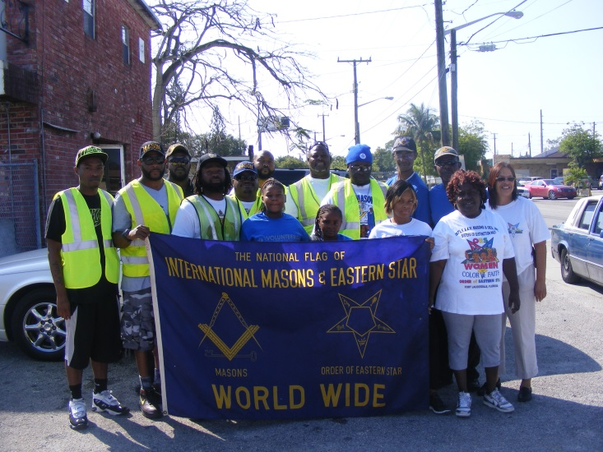
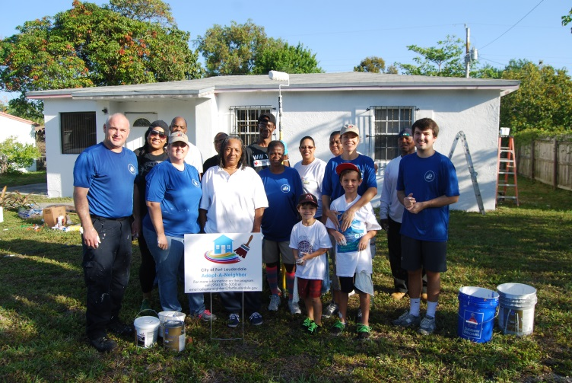
Neighbor Volunteer Office
Volunteerism is the Spirit of Fort Lauderdale!
We are proud to offer hundreds of event and part-time volunteer opportunities in almost every department.
The City is also creating a vibrant network of public/private partnerships made up of business leaders, civic associations, and neighbors by engaging citizens in solving City problems to achieve measurable impact on pressing local challenges, such as education, health, sustainability, and disaster preparedness.

Slide 22
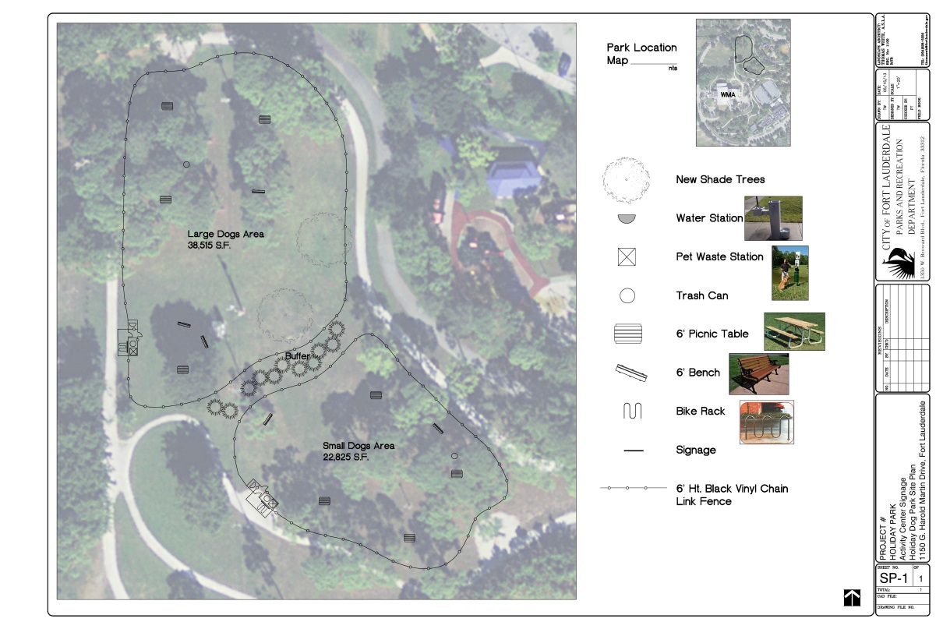
Recruiting Neighbors
Our neighbors can assist us with our mission to engage the entire system.
Prime example: Holiday Park Dog Park fundraising initiative.
Enthused, passionate neighbors ARE our best assets!

Slide 23
Conclusion
“A fundamental point is that citizen engagement must involve actual engagements rather than simply an exchange of information. The basic test of engagement is whether citizens have the opportunity to discuss ideas or efforts with other citizens and officials to better understand each other.”
James Svara and Janet Denhardt

Slide 24
For More Information
Ryan Henderson
Management Fellow
City Manager’s Office (Neighbor Support)
City of Fort Lauderdale
Rhenderson@fortlauderdale.gov
(954) 828-5213

