Slide 1
You are automatically muted when you arrive in the webinar.
You can type comments and questions in the question box.
Raise your hand if you have questions and we can unmute you.
Talking about the tough stuff so we can find solutions together

Slide 2
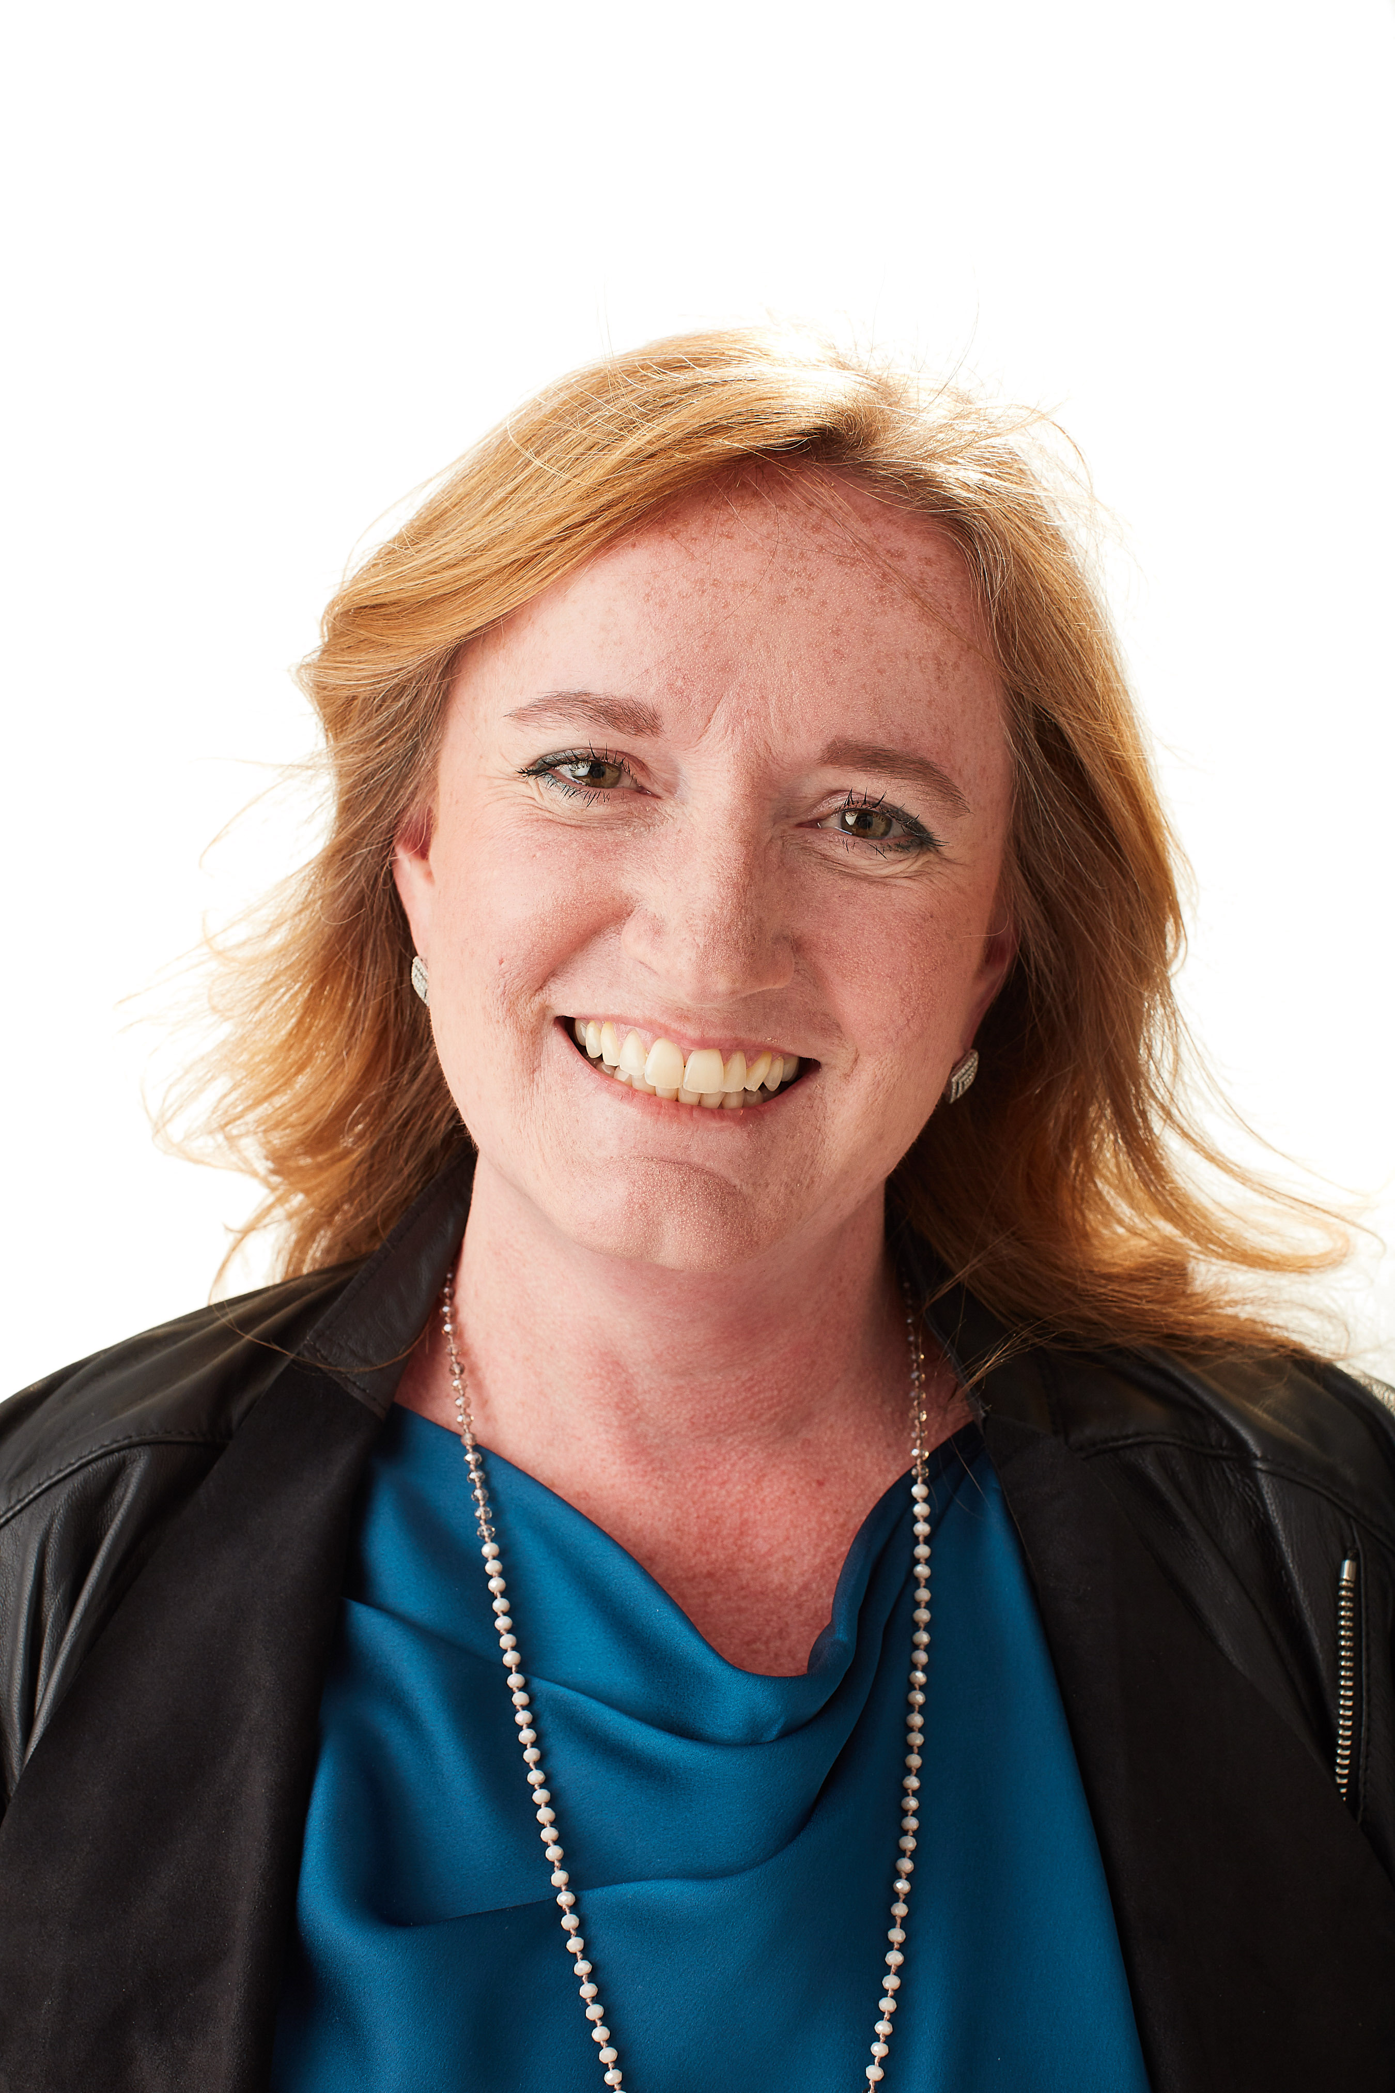
Courageous Leadership Project www.bravelylead.com
Stephani Roy McCallum
Chief Storm Rider
What made you say “yes” to a webinar about brave, honest conversations?

Slide 3
What are the brave, honest conversations you need to be having?
What topics or issues are running your world?

Slide 4
Brave, Honest Conversations
What is a brave, honest conversation to you?
What would be in your “manifesto” for a brave, honest conversation?
What leadership mindset does it take to have brave, honest conversations?

Slide 5
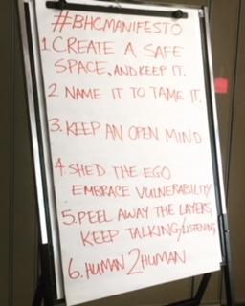
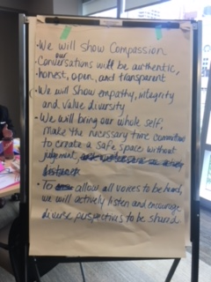
Manifestos

Slide 6
My Manifesto for Brave, Honest Conversations
Practice courageous leadership
Work with the whole system
Embrace the whole person
Recognize right & responsibility
Practice meaningful inclusion
Come from a place of compassion & integrity
Do it again and again

Slide 7
What is courage? What does it mean to be brave?
How do you find your courage to have brave, honest conversations?

Slide 8
Step into Courage
1. Breathe and Connect to WHY you are doing this.
2. ACT. Stop thinking and DO.
3. Get curious. Stop judging.

Slide 9
Step into Courage.
4. Bless other’s right to a voice.
5. Set Firm Boundaries with a Generous Heart.

Slide 10
Step by Step for BHC’s Gather your COURAGE PREPARE yourself Be PRESENT & LISTEN deeply STEP BACK: see landscape, patterns, insights Be VULNERABLE, open, question assumptions Take RESPONSIBILITY for IMPACT Use your SKILLS & KNOWLEDGE in SERVICE Seek ALIGNMENT vs. agreement Repeat
Make it your own
The process looks linear but it is more often iterative. Do it again. And again.

Slide 11
Prepare Yourself! Deal with your FEARS Deal with your EGO Know WHY you want to have the conversation Be prepared for DISCOMFORT Be REAL about expectations Set the emotional TONE for conversation Avoid MISTAKES (as much as possible)
Make it your own
What would you ADD or CHANGE to make the preparation process REAL for YOU?

Slide 12
Join me: Bravely Lead LIVE! 3 days of Brave, Honest Conversations Coming June 2019!
Brave Honest Conversations:
2019 training schedule coming in November (online & face-to-face)
Bravely Lead LIVE conference / gathering / experience in June 2019
March 2019 IAP2 Canada Skills Symposium
www.bravelylead.com
stephani@bravelylead.com

Slide 13
Get the step by step lists & tips for brave, honest conversations
Text IAP2TIPS to 867-992-2162 and they will be sent directly to you

